Slide 1

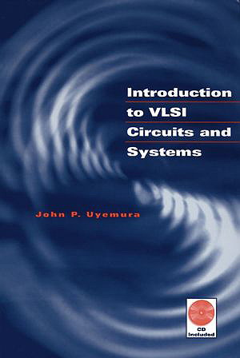
Chapter 08
Designing High-Speed CMOS Logic Networks
Introduction to VLSI Circuits and Systems
積體電路概論
賴秉樑
Dept. of Electronic Engineering
National Chin-Yi University of Technology
Fall 2007

Slide 2
Outline
Gate Delays
Driving Large Capacitive Loads
Logical Effort
BiCMOS Drivers

Slide 3


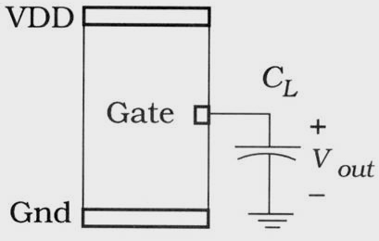
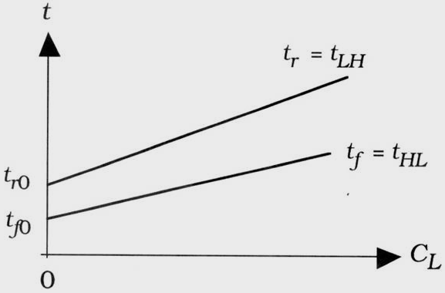
Gate Delay
In VLSI, the ability to meet system timing targets is intimately related to the switching speed of the logic circuits
  The output switching times of the CMOS logic gate
(8.1)
Figure 8.1 Output switching times

Slide 4
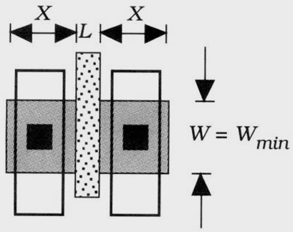
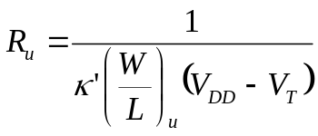
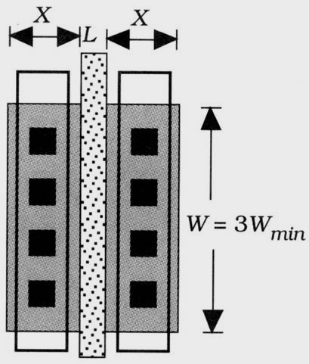



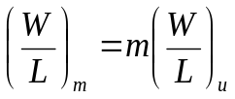
Minimum-size MOSFET
The drawn aspect ratio (W/L) and the active dimension X are determined by the design rules
  We can define the parasitical R and C for the device by design rules
  While
  To create a design methodology, we will specify that all transistor size are integer multiples of the minimum width W_{min} = W_{u}
(8.2)
(u: unit FET parameters)
(a) Minimum-size
(8.3)
(u: unit FET parameters)
(8.4)
(b) 3X scaled FET (m=3)
with m=1,2, 3, …as the size specifier
Figure 8.2 Unit transistor reference

Slide 5
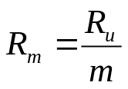




mX Scaled FET
The resistance and gate capacitance of the m-size FET are written in terms of the unit transistor as
(8.5)
(a) Minimum-size
(8.6)
constant
(8.7)
This is true by the Scaling Theorem in chapter 07
(b) 3X scaled FET (m=3)
Figure 8.2 Unit transistor reference

Slide 6

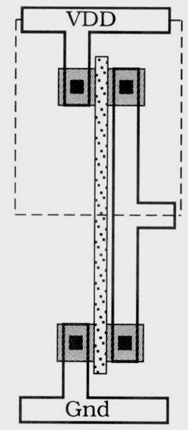
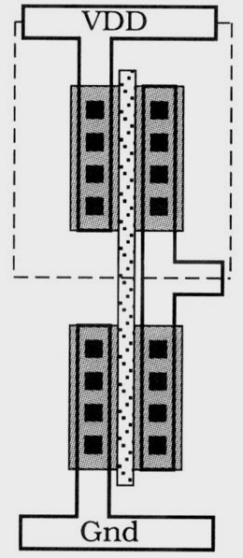


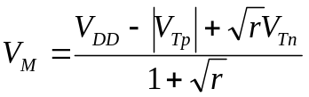
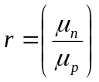

Inverter Using Scaled Transistors (1/2)
Rise and Fall time with scaled technology (Figure 8.3(a), unit gate)
  Since R_{p} > R_{n}, t_{r0} > t_{f0}, and , for a given load C_{L}, t_{ru} > t_{fu}. The midpoint voltage is
  The input capacitance is a minimum value for a complementary pair
  However, this does not change the midpoint voltage, but does alter the switching times
    The response time of the new circuit→ next slide
(8.8)
(rise time is controlled by pFET)
(8.9)
(fall time is controlled by nFET)
(8.10)
(Mid. Voltage of an inverter)
where is the mobility ratio
(a) Unit Inverter
(b) m = 3
(8.11)
Figure 8.3 Inverter designs using scaled transistors

Slide 7
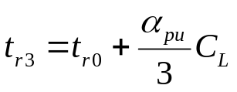
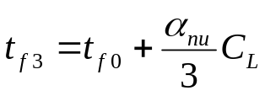

Inverter Using Scaled Transistors (2/2)
The response of the new circuit (Figure 8.3(b), m = 3)
  The zero-load times t_{r0} and t_{f0} are (approximately) constants and the slope parameter decrease as (1/m) because of the decrease in resistance by the same factor. Thus,
  The input capacitance for this gate is
(8.12)
(under s = 3)
(8.13)
(under s = 3)
(a) Unit Inverter
(b) m = 3
Figure 8.3 Inverter designs using scaled transistors

Slide 8
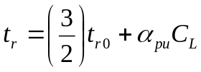
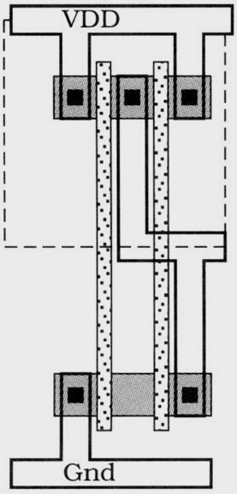
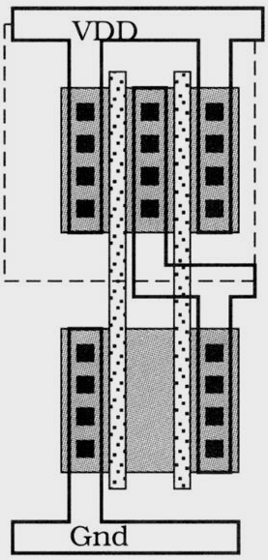








NAND Using Scaled Transistors
Minimum-size NAND2
  Since an nFET/pFET pair consists of minimum-size devices, the input capacitance is
NAND2 with m = 3
  The input capacitance is
(8.14)
(Unit NAND2)
(8.15)
(8.16)
(8.17)
(a) Unit transistors
(b) m = 3
(8.18)
Figure 8.4 NAND2 gate scaling
(NAND-N)
If N is the fan-in (number of inputs), then we may extrapolate the analysis to write
For an N-input NAND gate that use m-sized FETs

Slide 9




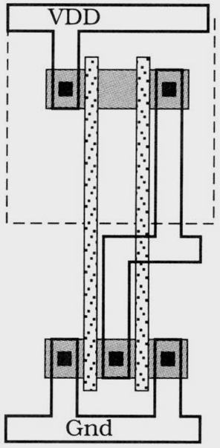
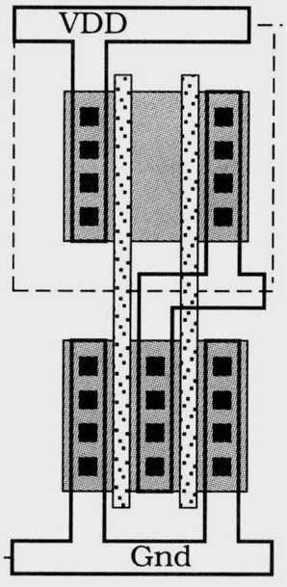



NOR Using Scaled Transistors
Minimum-size NOR2
  For M = 3
  For N inputs and general scaling factor m
  These equations clearly demonstrate the dependence of the switching times and input capacitance on
    Number of inputs N (fan-in)
    Transistor scaling factor m
(8.21)
(Unit NOR2)
(8.22)
(8.23)
(Unit NOR-N)
(8.24)
(a) Unit transistors
(b) m=3 circuit
Figure 8.5 NOR2 gate scaling

Slide 10
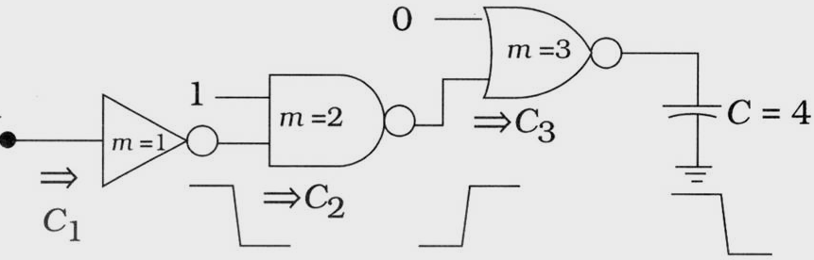


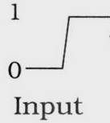







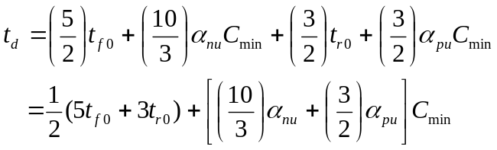
Delay Time Estimation (1/2)
For a logic chain with M stages, the total delay through the chain by summing the individual delays:
(8.25)
(8.26)
(t_{f})
(t_{r})
(t_{f})
Figure 8.6 Delay time example
(8.29)
(8.27)
(8.30)
(8.31)
(minimum-size inverter)
(8.28)
(β_{n} ≠ β_{p})
(β_{n}=β_{p,} W_{n}=W_{min} and W_{p}=rW_{min})

Slide 11

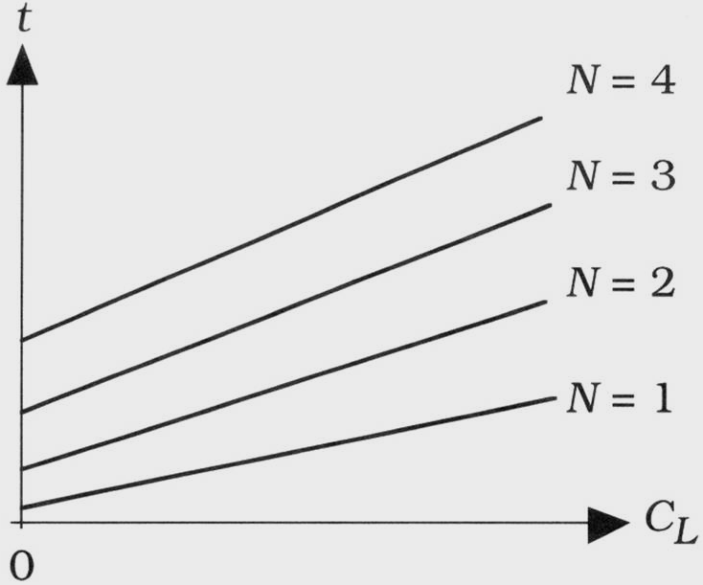

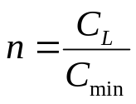


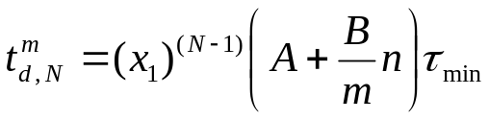
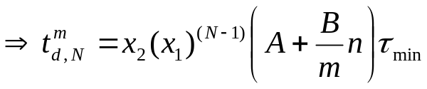
Delay Time Estimation (2/2)
Using the minimum-size inverter (β_{n}=β_{p}) as a basic, and then build up NAND and NOR gates for increasing numbers of inputs N
(8.32)
(8.33)
(8.34)
(8.35)
(8.36)
Figure 8.7 Delay times as a function of fan-in N
(8.37)
(8.38)

Slide 12
Outline
Gate Delays
Driving Large Capacitive Loads
Logical Effort
BiCMOS Drivers

Slide 13
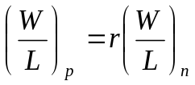

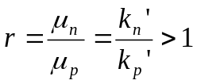

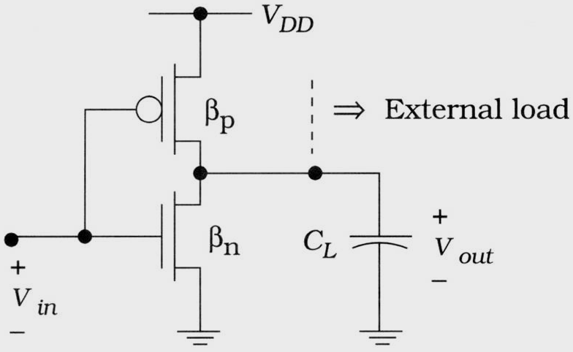
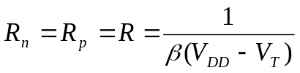
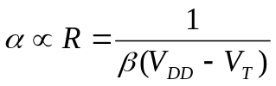


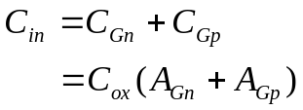
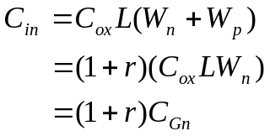

Driving Large Capacitive Loads
High speed design can be obtain from studying the characteristic delay through inverter
(8.42)
(8.47)
(8.43)
(8.48)
(assume t_{s} = t_{r} = t_{f})
(8.44)
(8.49)
(8.45)
(8.50)
Figure 8.8 CMOS inverter circuit
(p-network pre-charge function)
(8.51)
(8.46)
(n-network dis-charge function)

Slide 14
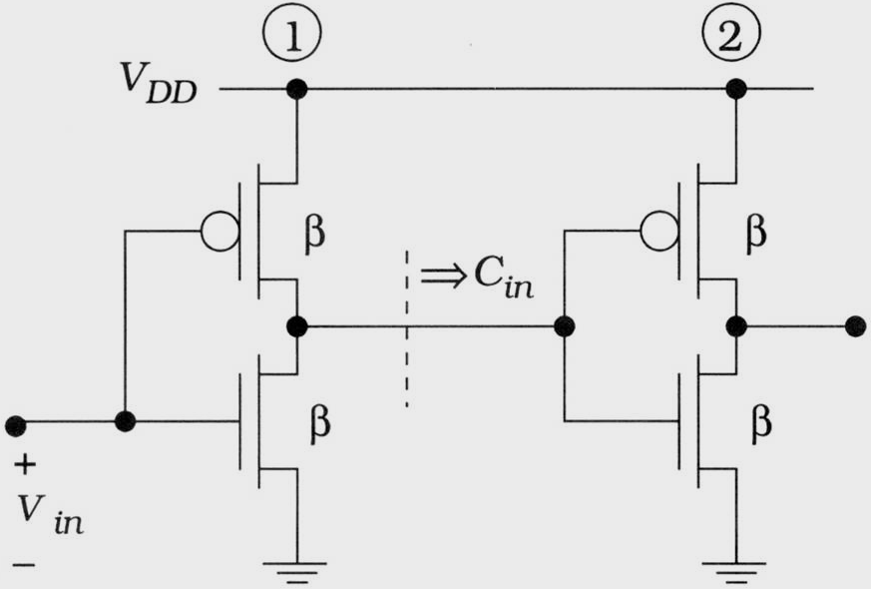



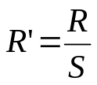
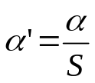
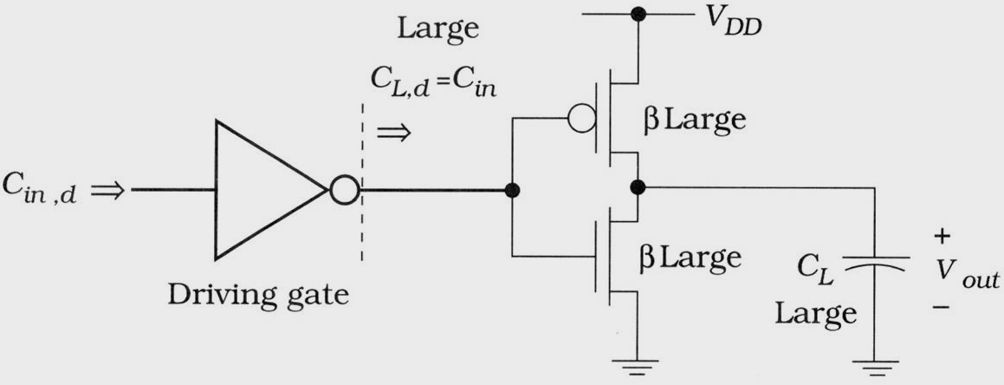
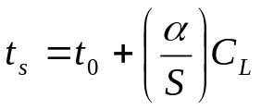


Unit Load
Figure 8.9, since the load capacitance is the same as the gate’s own input capacitance , we call this a unit load value
C_{L1}
(unit load)
(8.52)
(switching time)
(8.53)
(When C_{L} >> C_{in}, using S > 1)
(8.54)
Figure 8.9 Concept of a unit load
(8.55)
(8.52)
(new switching time)
(8.53)
(When C_{L}=S C_{in}, using S > 1)
(8.54)
Figure 8.10 Driving a large input capacitance gate
(8.55)

Slide 15
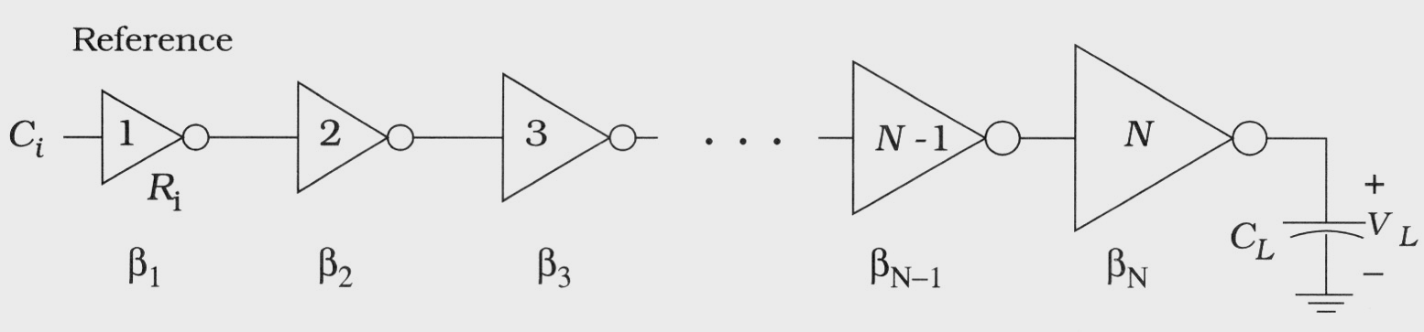
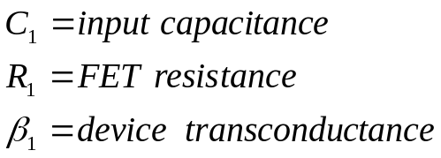



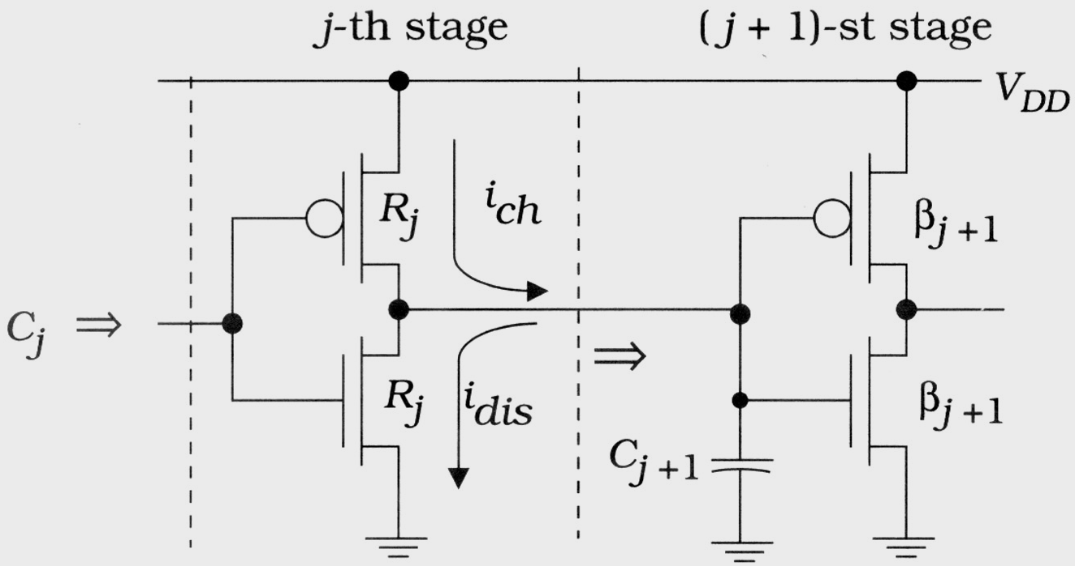







Delay Minimization of Inverter Cascade, ideal case (1/3)
In figure 8.11. To drive the large load capacitance, let the 1-th be the unit gate
(1-th stage parameters)
Figure 8.11 Inverter chain analysis
(8.60)
(8.64)
(8.61)
(8.65)
(8.62)
(8.66)
(8.67)
(8.63)
(assume C_{j+1} >> C_{FET,j})
Figure 8.12 Characteristics of a typical stage in the chain

Slide 16








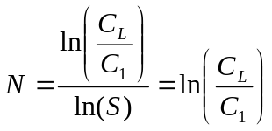



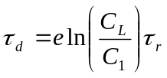
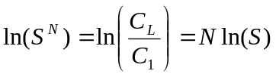
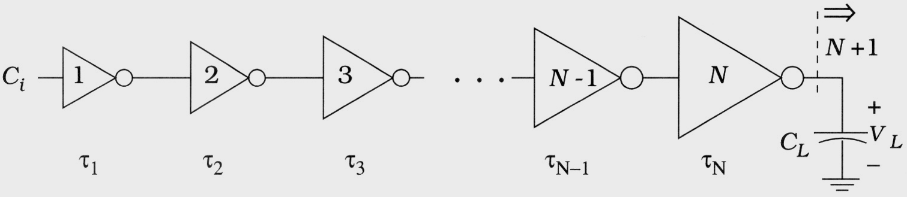
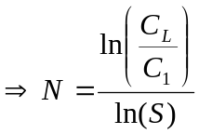
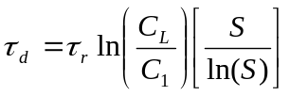
Delay Minimization of Inverter Cascade, ideal case (2/3)
(8.68)
(N stages)
(8.77)
(8.69)
(8.78)
(8.70)
(8.79)
(8.71)
(8.80)
(e = 2.71…)
(8.72)
(8.81)
(8.73)
(8.82)
(8.74)
(8.75)
Figure 8.13 Time constants in the cascade
(8.76)

Slide 17

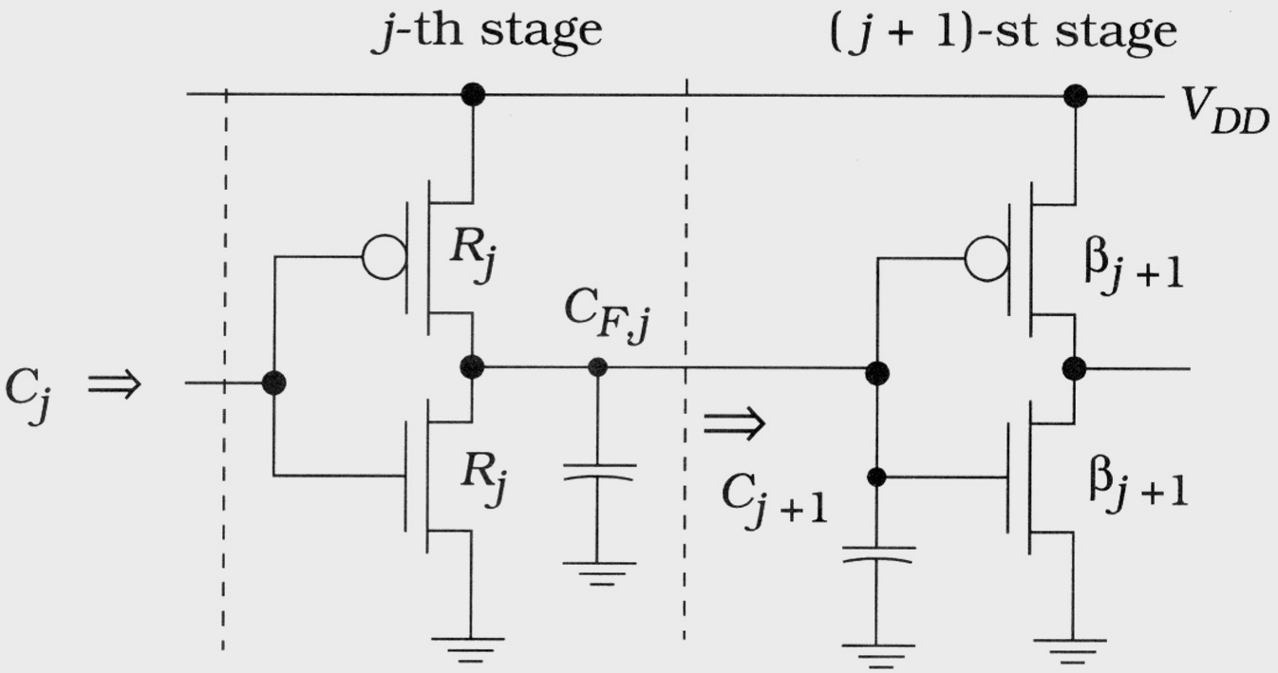


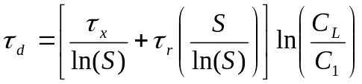

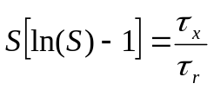
Delay Minimization of Inverter Cascade, in physical (3/3)
Figure 8.14 shows the j-th stage circuit with the parasitic FET capacitance C_{Fj} included at the output → S > e (in physical design)
(8.68)
(8.69)
(8.70)
(8.71)
(8.72)
Figure 8.14 Driver chain with internal FET capacitance
(8.73)
(8.74)

Slide 18
Outline
Gate Delays
Driving Large Capacitive Loads
Logical Effort
BiCMOS Drivers

Slide 19







Logical Effort
Logical effort characterizes gates and how they interact in logic cascades, and provides techniques to minimize the delay
  Basic definition starts with an inverter, and uses a symmetric NOT gate, where
  The logical effort g of a gate is defined by the ratio of capacitance to that of the reference gate:
  For the 1X inverter, , where A_{Gn} = W_{n}L and A_{Gp} = W_{p}L
(8.98)
(8.99)
Figure 8.15 Reference inverter for logic effort
(8.102)
(8.103)

Slide 20












Electrical Effort
Electrical effort h is defined by the capacitance ratio
  It is the ratio of electrical drive strength that is required to drive C_{out} relative to that needed to drive its own input capacitance C_{in}
  The absolute delay time d_{abs} through the inverter is written in the form
(8.104)
(8.105)
(8.106)
(8.110)
(8.107)
(8.108)
(8.111)
(8.112)
(In chapter 07, k=ln(9)≒2.2)
(8.109)
(8.113)
Figure 8.16 Delay circuit for a 1X inverter
(8.114)

Slide 21











Logical Effort Examples
2-Stage inverter chain
(8.115)
(8.116)
(8.117)
(path electrical effort)
(8.118)
(8.119)
Figure 8.17 2-Stage inverter chain
(8.120)
(8.121)
(8.122)
(8.123)
(since H=h₁h₂)
(8.124)

Slide 22






Logical Effort Generalization (1/2)
The real power of the Logical Effort tech. is that it can be generalized to include arbitrary CMOS logic gates
All calculations are reference to the 1X reference inverter with an input capacitance C_{ref} and transistor resistance R_{ref}
In figure 8.18(a)
In figure 8.18(b)
(a) NAND2
(8.125)
(C_{in} of NAND2)
(8.126)
(logical effort of NAND2)
(8.127)
(C_{in} of NOR2)
(b) NOR2
(8.128)
(logical effort of NOR2)
Figure 8.18 Symmetric NAND and NOR gates

Slide 23
















Logical Effort Generalization (2/2)
Generalize to larger fan-in gates, an n-input NAND and NOR gate
(8.129)
(NAND2)
(path effort)
(8.137)
(8.130)
(logical effort of NAND2)
(8.138)
(min. delay)
(8.131)
(logical effort of NOR2)
(8.139)
(min. path delay)
(8.132)
(8.140)
(design reference)
(8.133)
(8.141)
(8.134)
(total path delay)
(8.142)
(min. path delay)
(8.135)
(path logical effort)
(8.143)
(8.136)
(path electrical effort)
(8.144)
(n-stage parasitic)

Slide 24




Optimizing the Number of Stages
A well-known characteristic of CMOS logic cascades is that the fact that one can often insert inverters into a logic chain and decrease the total delay time
Logic Effort shows this feature using the path delay D
Therefore, it may be possible to obtain a smaller path delay by inserting the inverters (buffer inversion)
  A large memory cell array and it’s peripheral circuit, e.g. address decoder
  Placement and routing of FPGA application
(8.162)
(Note: logic effort of an inverter is g_{not} = 1)
(8.163)
(multiplying by additional factors of gnot does not change the numerical value of the path effort)
(8.164)
(Delay time minimization)
(8.165)
(the total path dealy)

Slide 25






Logical Area
With scaling theorem, an estimate of the circuit requirements can be obtained using Logical Effort quantities by simply summing the gate areas of each FET by calculating the logical area (LA) for the j-th gate using
(8.174)
(LA for the j-th gate)
(8.175)
(LA of 1X NOT gate)
(8.176)
(including scaling factor s > 1 with NOT gate)
(8.177)
(including scaling factor s > 1 with NOR2 gate)
(8.178)
(including scaling factor s > 1 with NAND2 gate)
(8.179)
(the total LA for a network with M gates)

Slide 26





Branching
The tech. of Logical Effort applied to a well-defined path. However, when a logic gate drives two or more gates, a branching concept must be considered
In Figure 8.20, two branching points between the primary In/Out
Figure 8.20 Branching
(8.180)
(branching effort b at every branch point)
(8.181)
(total capacitance seen at every branch node)
(8.182)
(path branching effort when b > 1)
(8.183)
(new path effort including branching effort)

Slide 27
Outline
Gate Delays
Driving Large Capacitive Loads
Logical Effort
BiCMOS Drivers

Slide 28
BiCMOS Drivers
BiCMOS is a modified CMOS technology that includes bipolar junction transistors as circuit elements
Used to drive high-capacitance line in digital design
More expensive, and have an intrinsic voltage drop that cannot be avoided making them undesirable for low-voltage application

Slide 29








BJT Characteristics
A Bipolar Junction Transistor (BJT)
  3-terminal element, pnp and npn
  npn is faster than pnp because electrons are faster than holes
  Forward-active bias
    For amplification and controlled current flow, and is used for analog circuits
  Reverse-active bias
    In this case, large current can flow through the device but the transistor does not control the values
  Saturation (can be used in digital as closed switch)
  Cutoff
    Can be modeled as an open switch
(a) Symbol
(b) Structure
Figure 8.21 npn BJT
(a) Symbol and parameters
(b) Operating regions
Figure 8.22 Operating regions of the BJT

Slide 30







Forward-active Bias of BJT
Bipolar are faster than MOSFETs but are more complicated to build into an integrated circuit
  Why a BJT can provide faster switching?
  In forward-active bias
  In Figure 8.24
(8.188)
(8.189)
Figure8.23 Forward-active bias in a BJT
where I_{s} is the saturation current and V_{th} is the thermal voltage
(8.190)
(8.191)
The values of I_{C} can reach 10 mA to hundreds of mA!
Figure 8.24 Discharge of a capacitor using a BJT

Slide 31





Diffuse Mechanism
A BJT accomplishes the task faster than a FET that occupies the same area, making BiCMOS attractive
  Since current flow through a BJT is due to the mechanism of particle diffusion, not electric field aided motion as in a FET
Electrons diffuse through the base
(8.192)
Where A_{E} [cm²] is the emitter area, D_{n} [cm²/sec] is the electron diffusion coefficient in the base and is a measure of the diffusive motion, q is the electron charge, and N_{aB} [cm⁻³] is the acceptor doping in the base
Figure 8.25 Forward-bias operation
(a) Cutoff
(b) Saturation
Figure 8.26 An integrated bipolar junction transistor
Figure 8.27 Cutoff and saturation in a BJT

Slide 32






Driver Circuits
BiCMOS circuits employ CMOS logic circuits that are connected to a bipolar output driver stage
  CMOS network provides logic operation and drive the output bipolar transistors Q₁ and Q₂
  Only one BJT is active at a time
  An inverter BiCMOS
(8.193)
(8.194)
Figure 8.28 General form of a BiCMOS circuit
(a) V_{OH} circuit
(b) V_{OL} circuit
Figure 8.29 An inverter BiCMOS driver circuit
Figure 8.30 DC analysis of the output voltages

